Slide 1

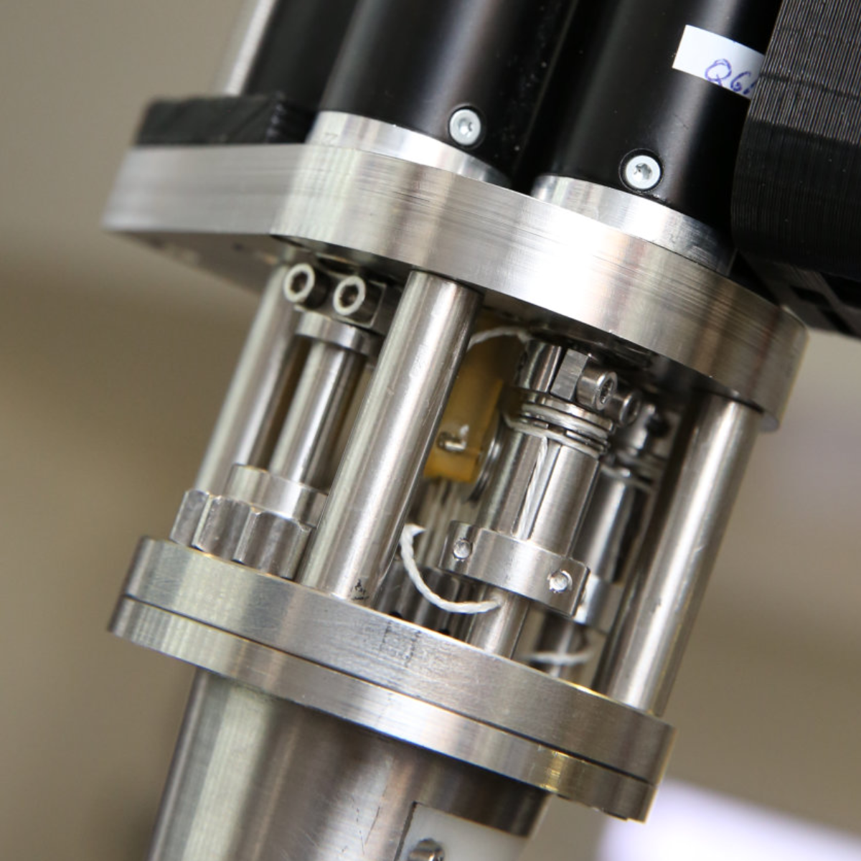
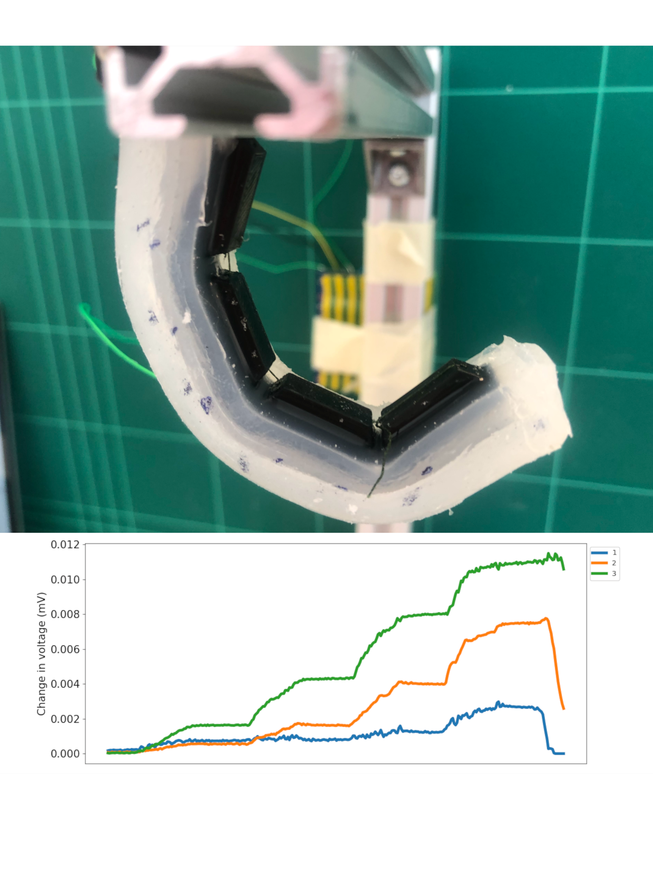


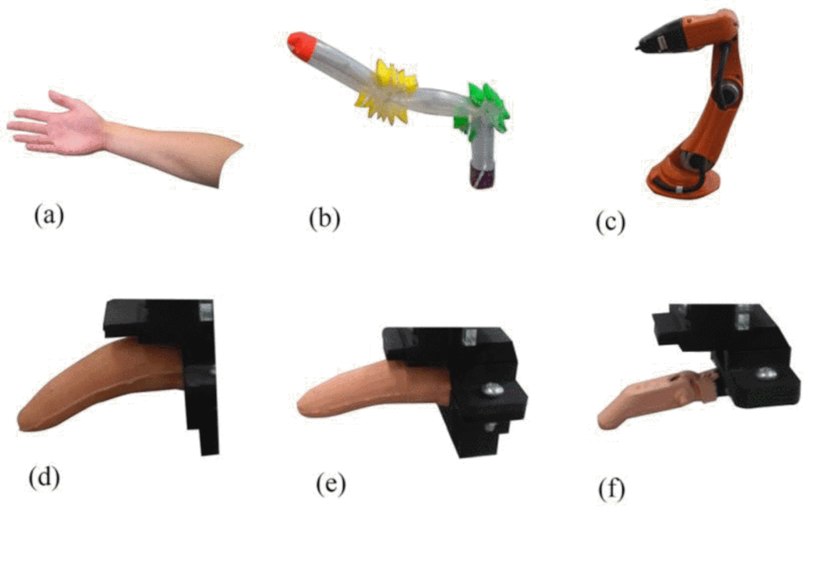
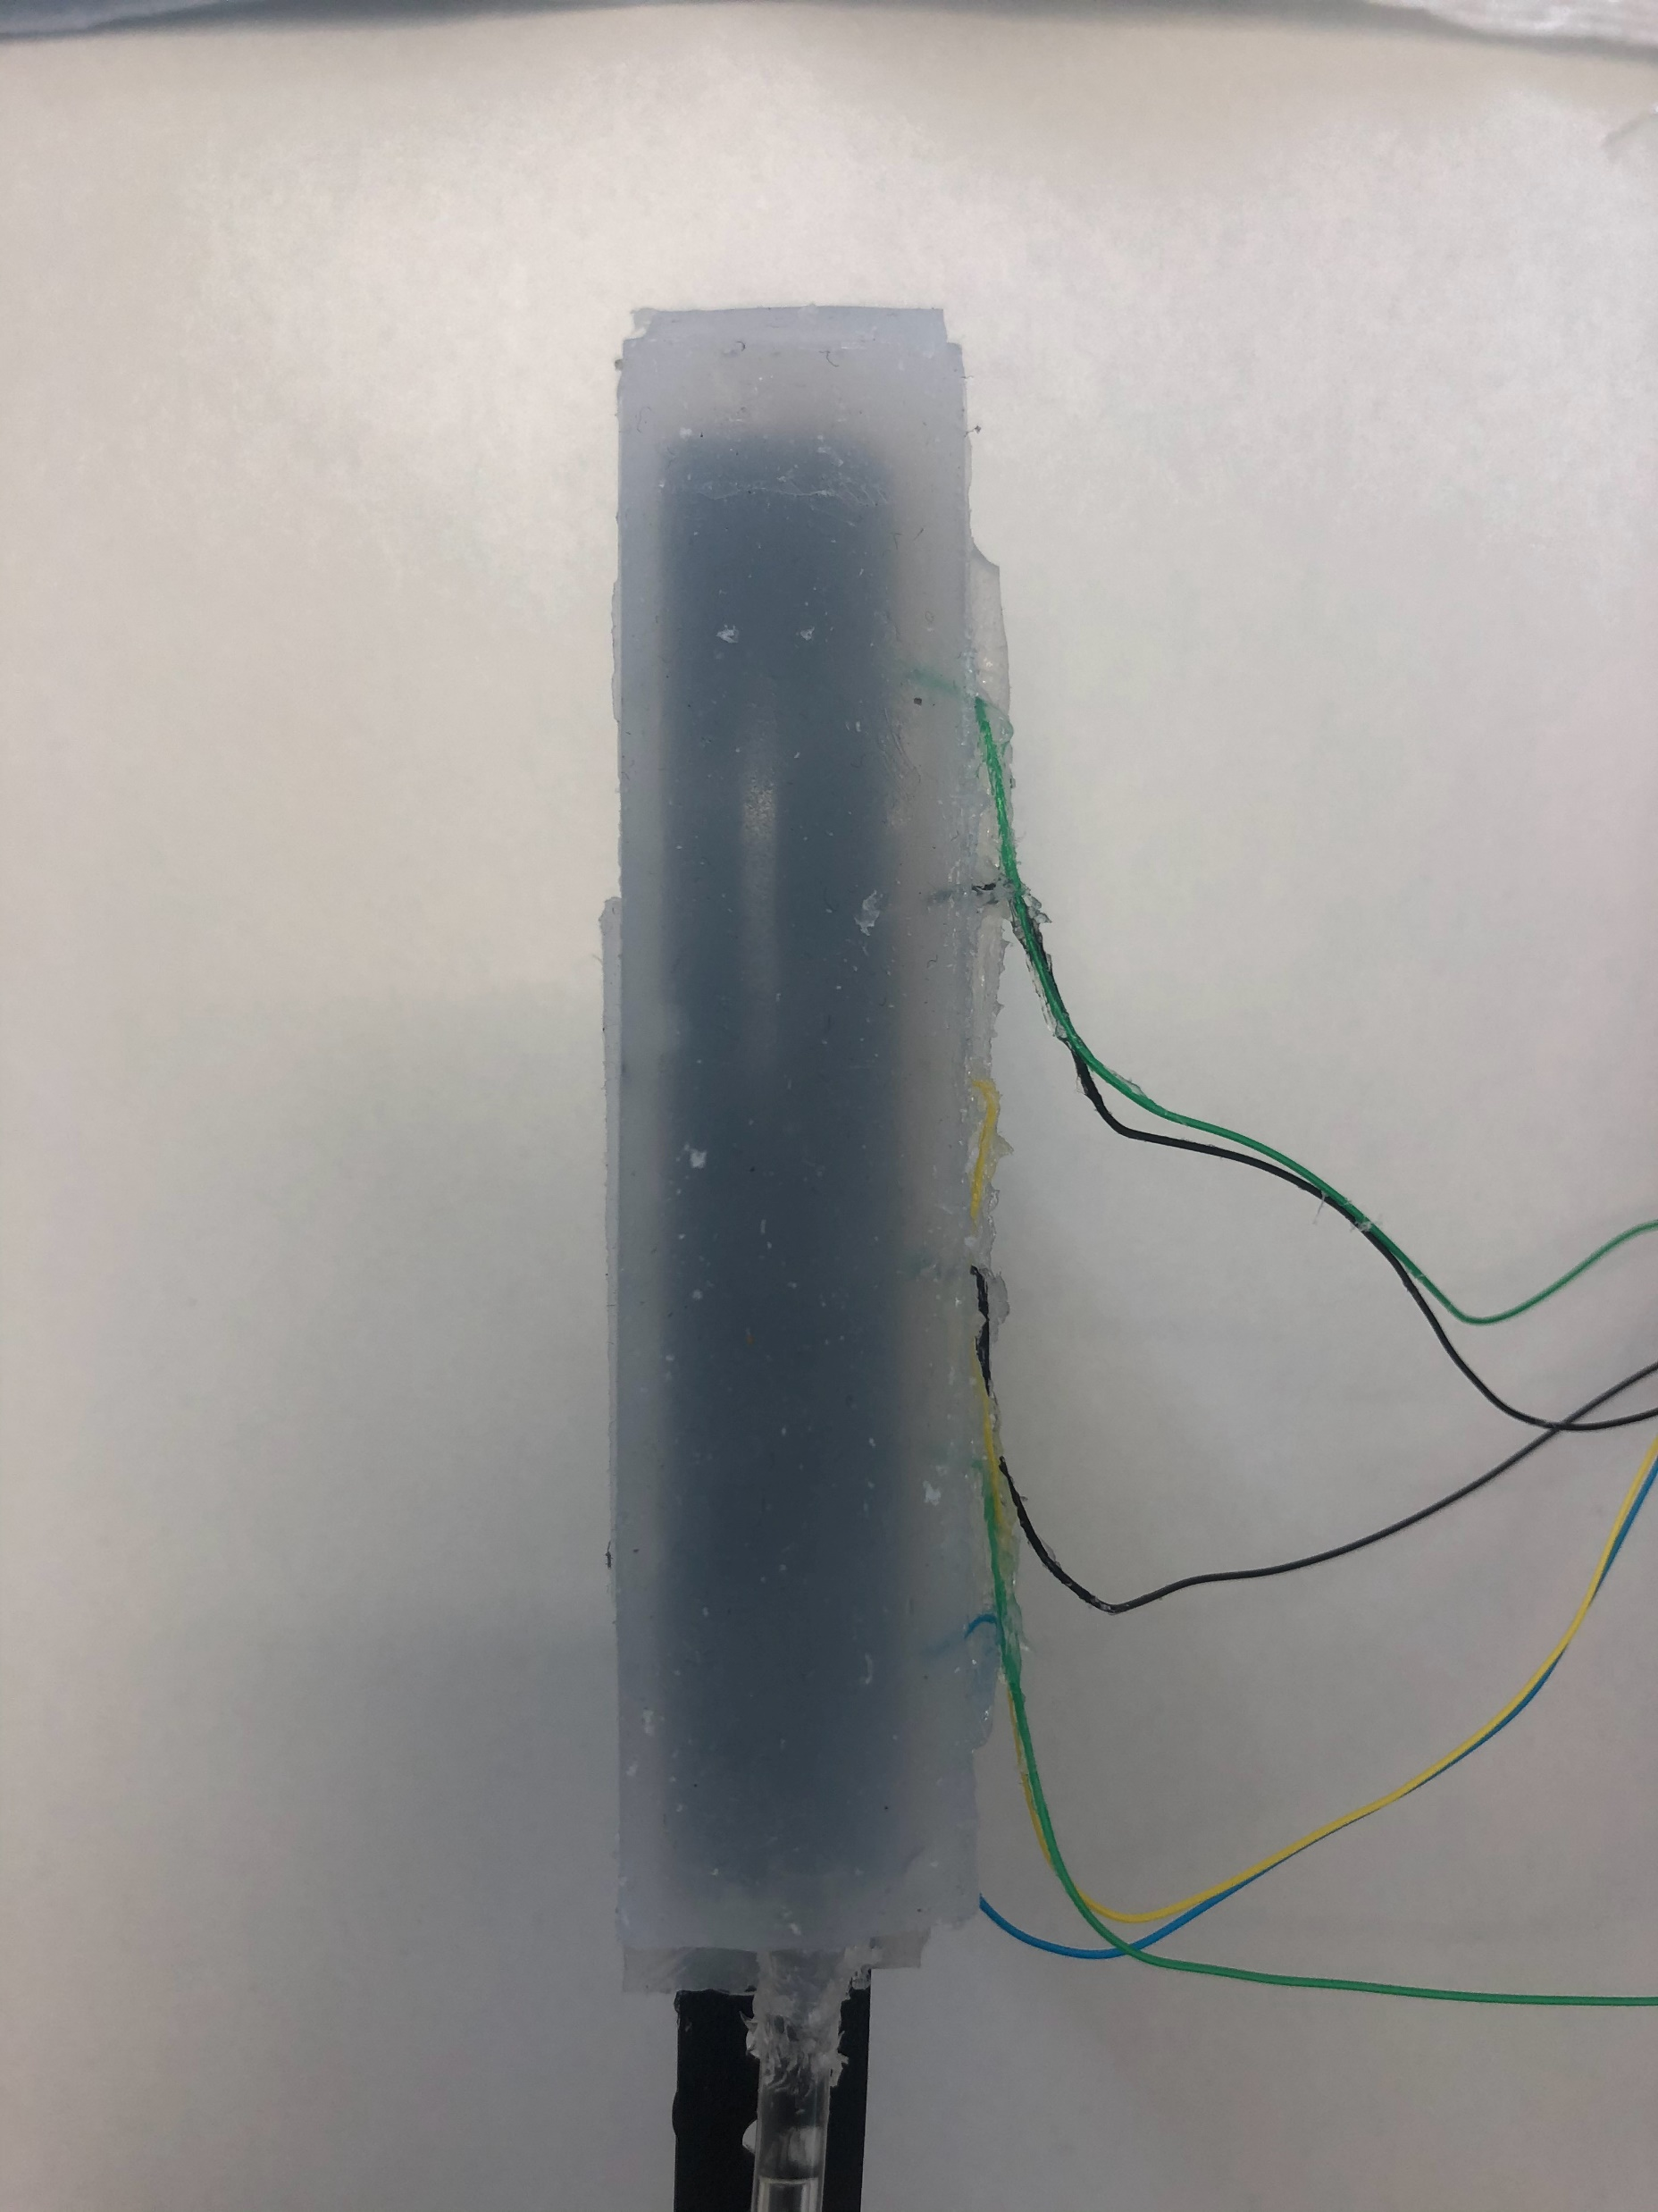
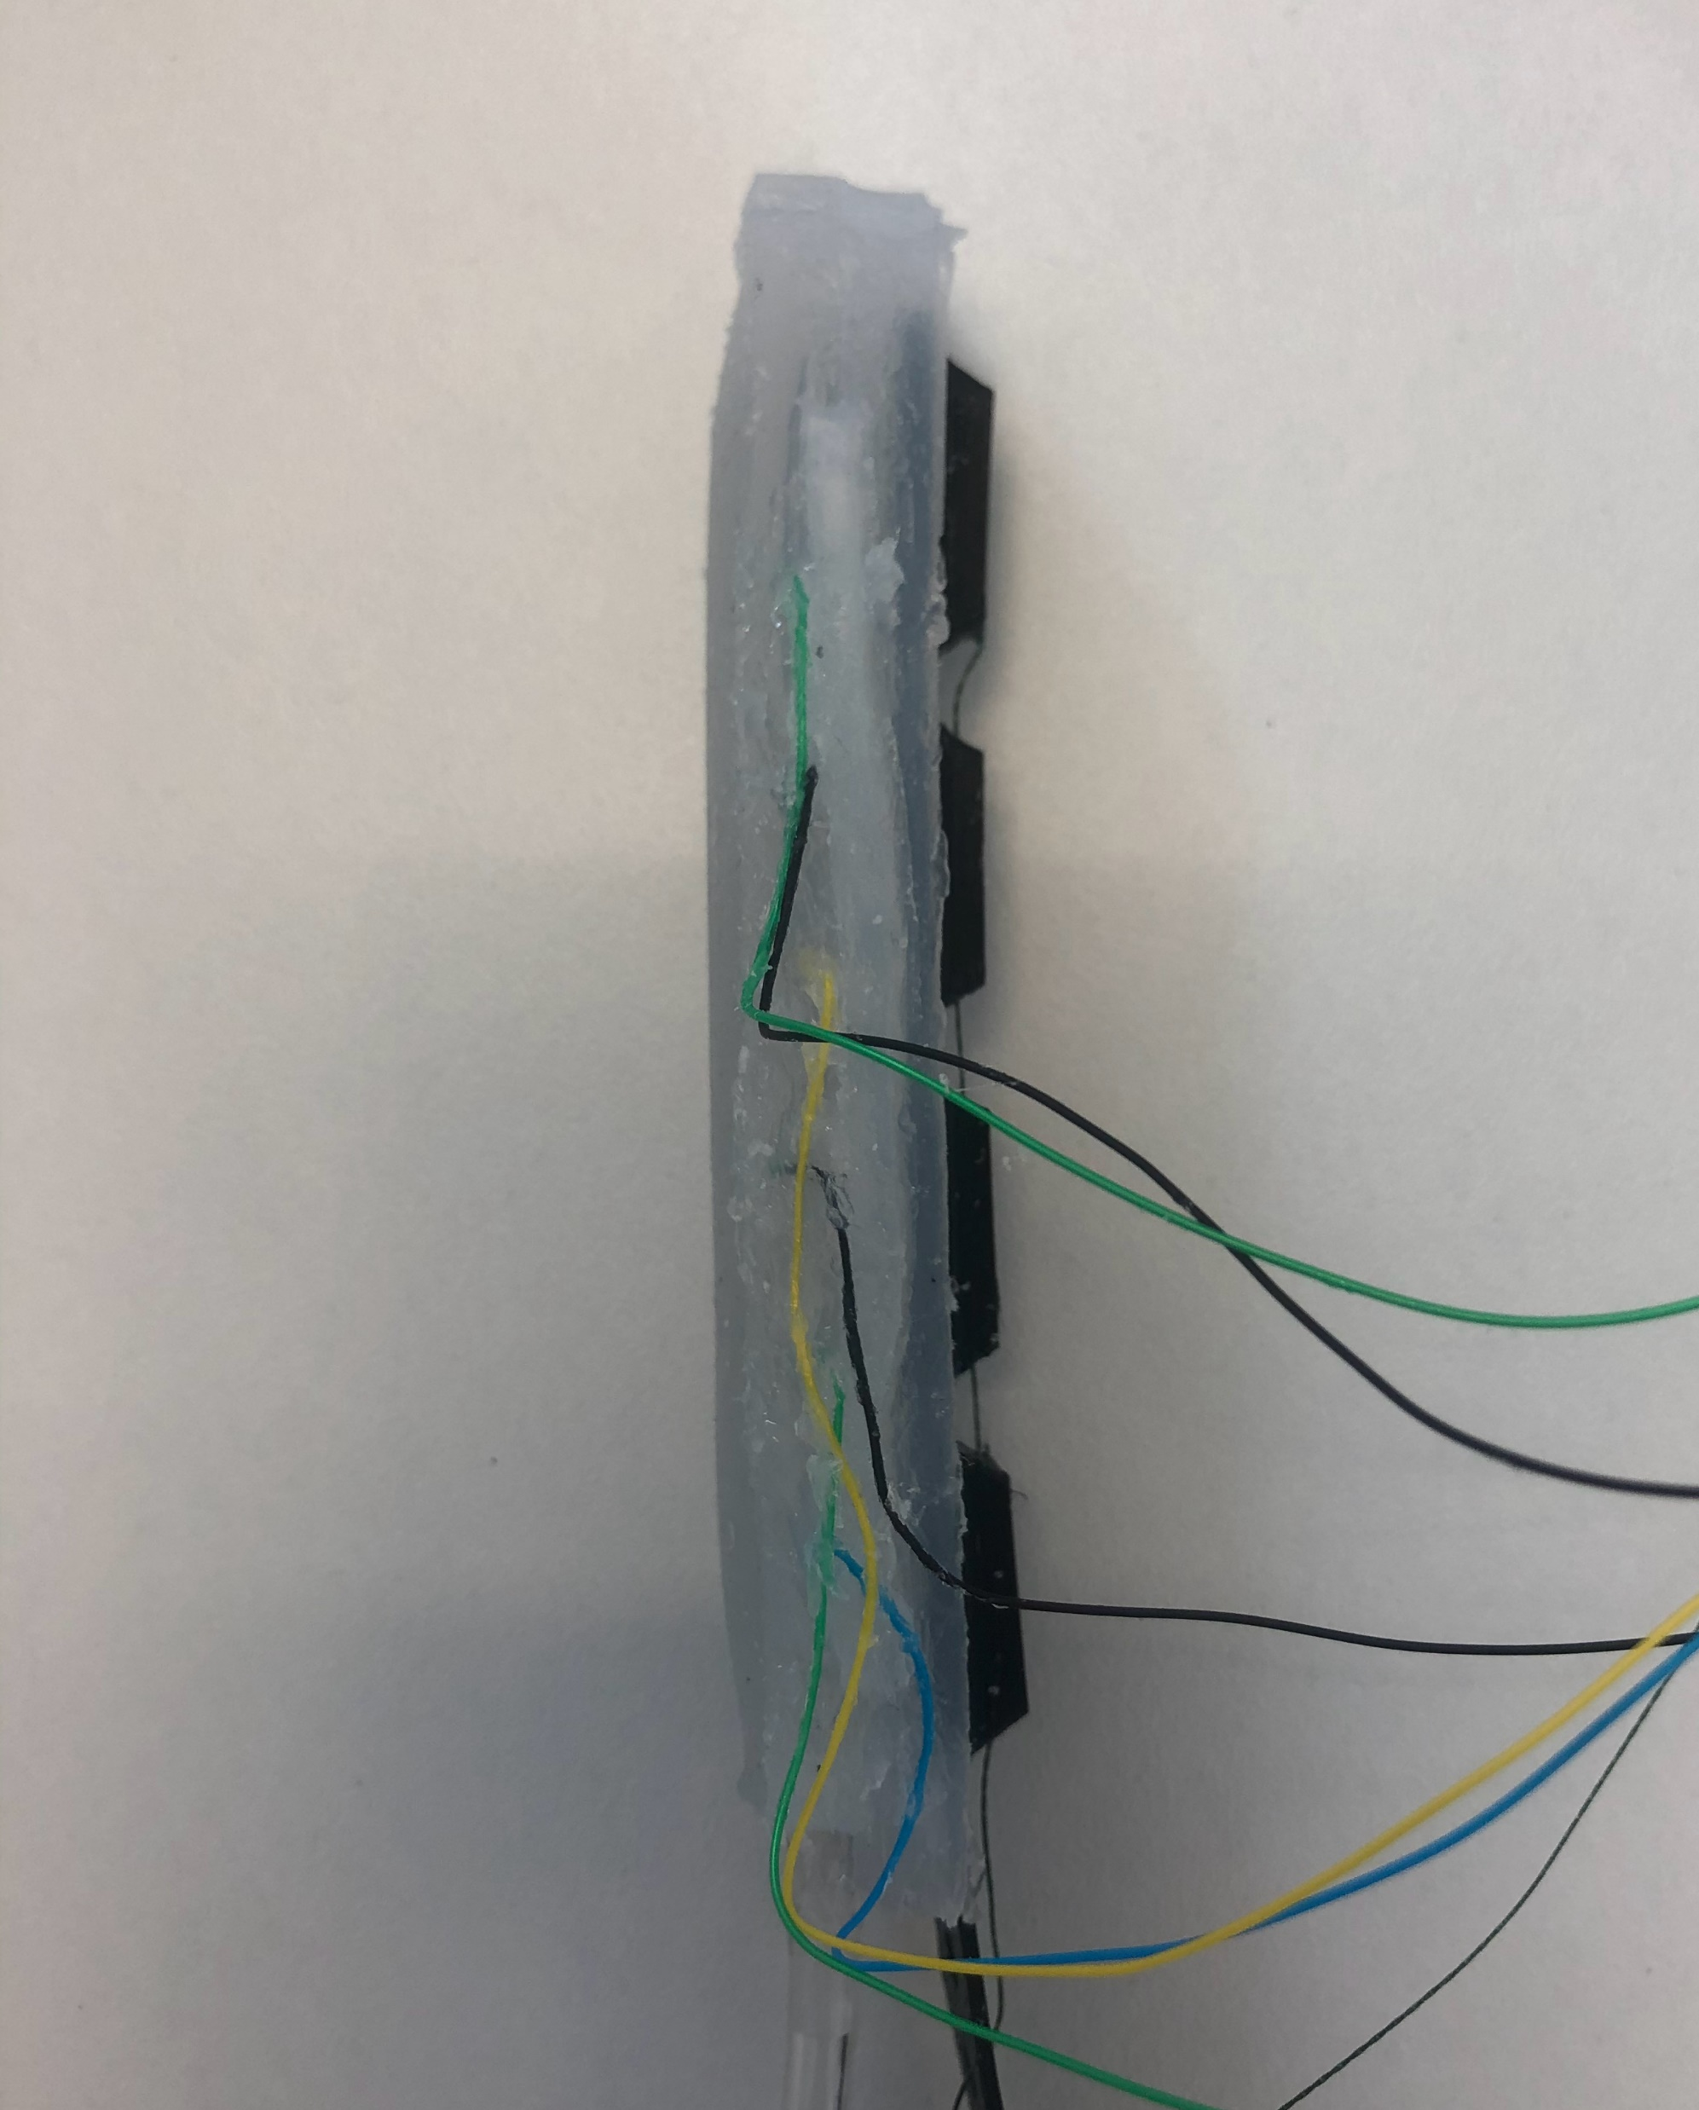
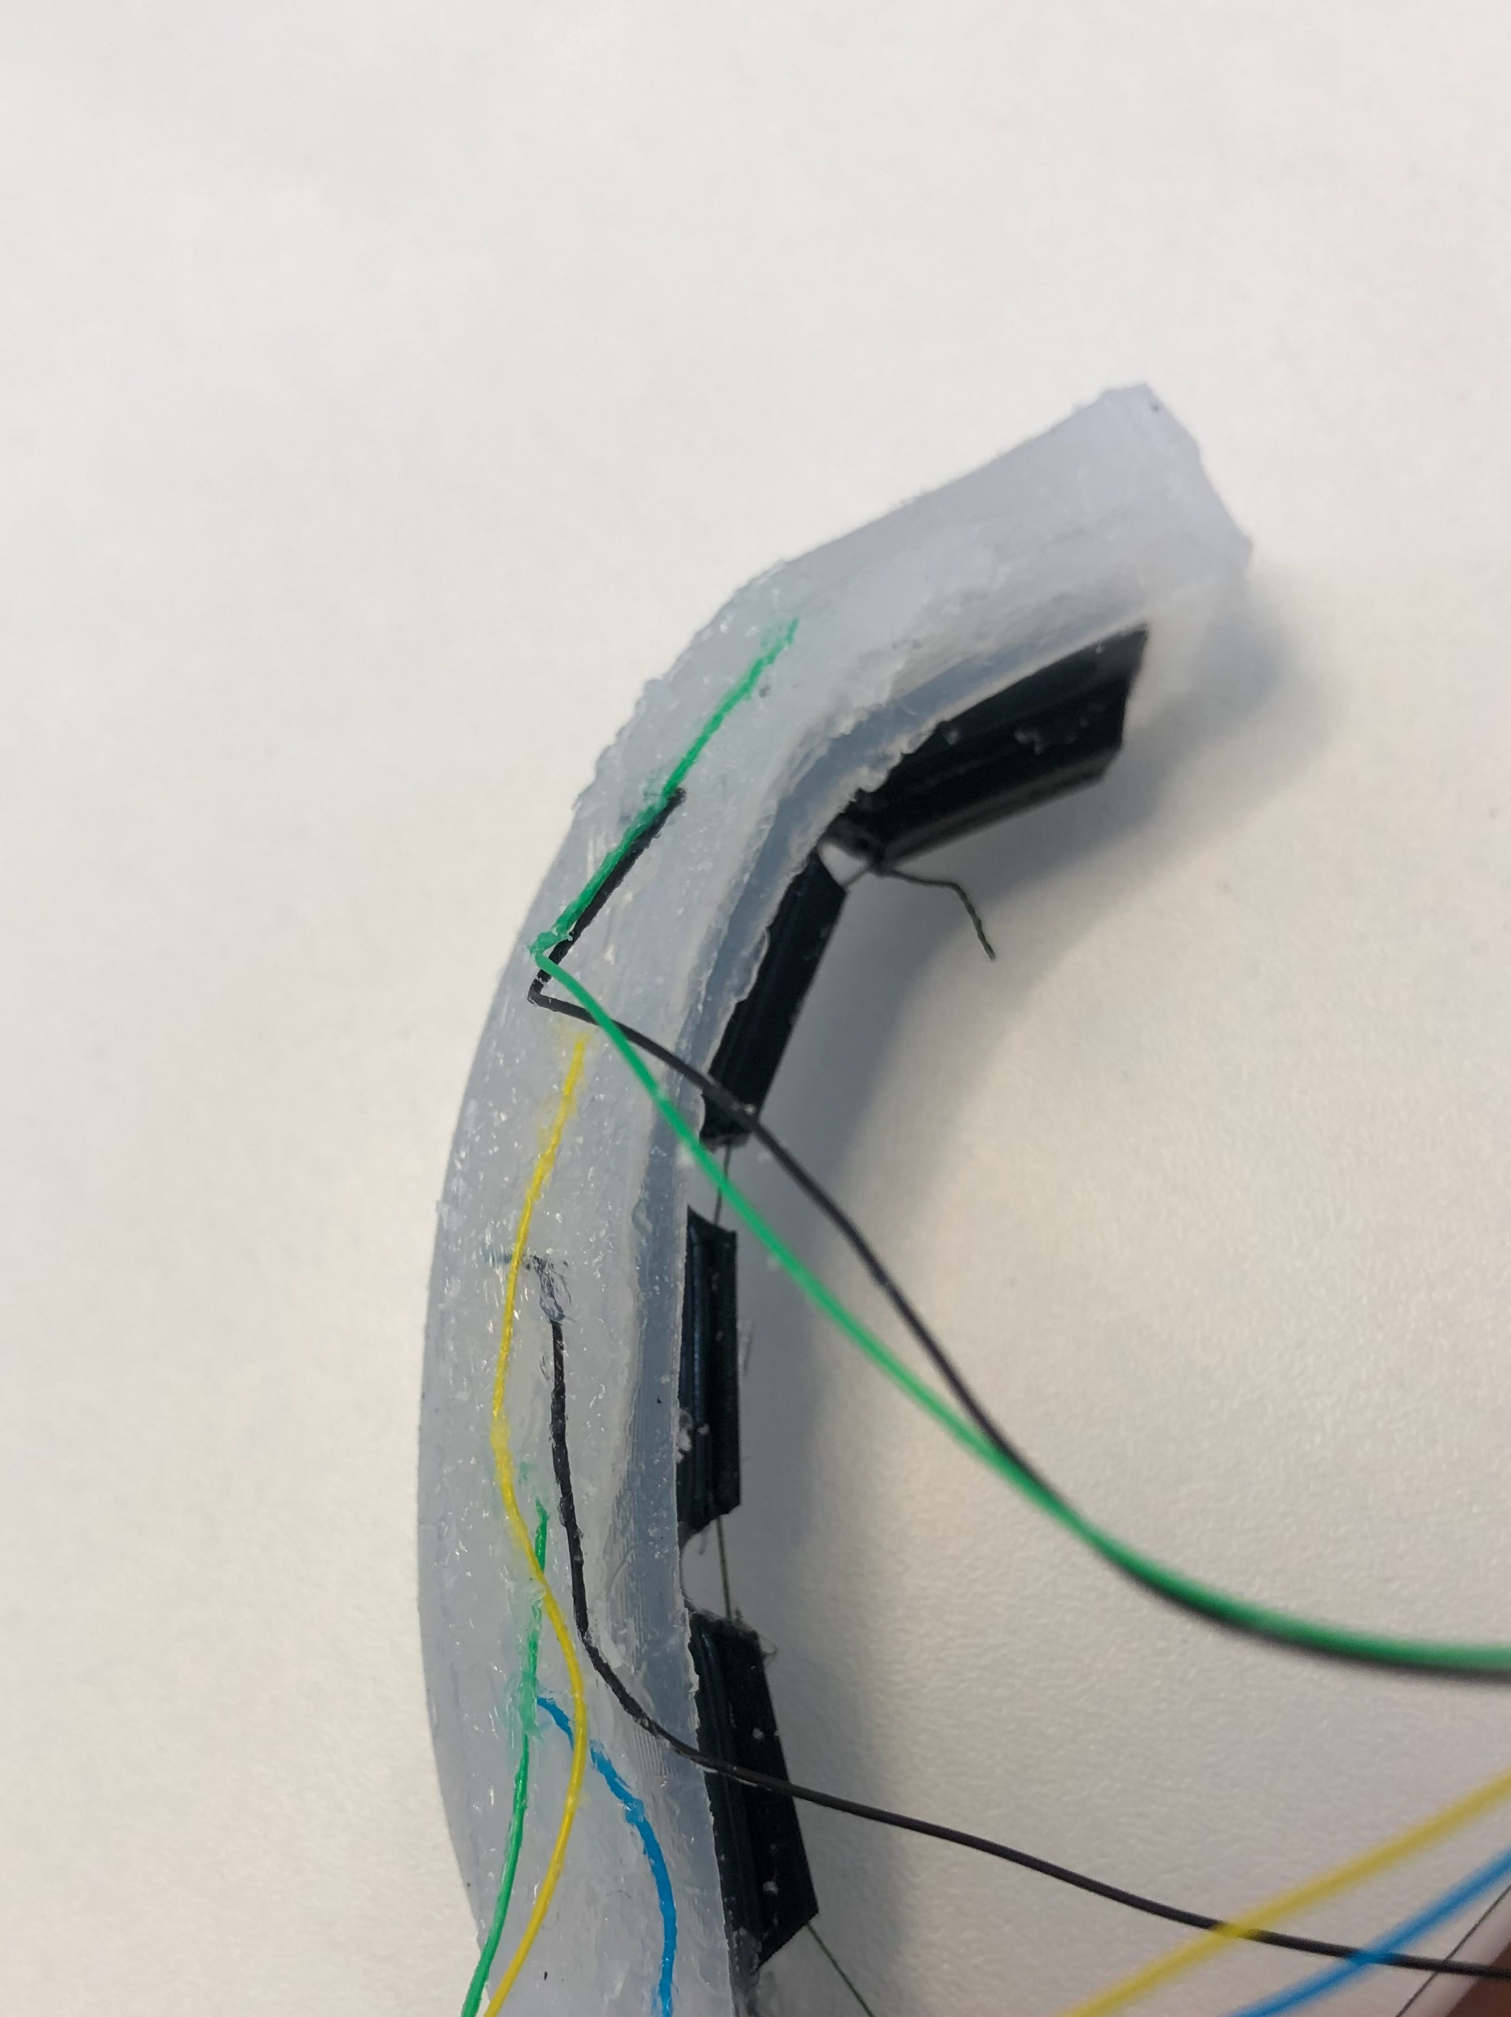
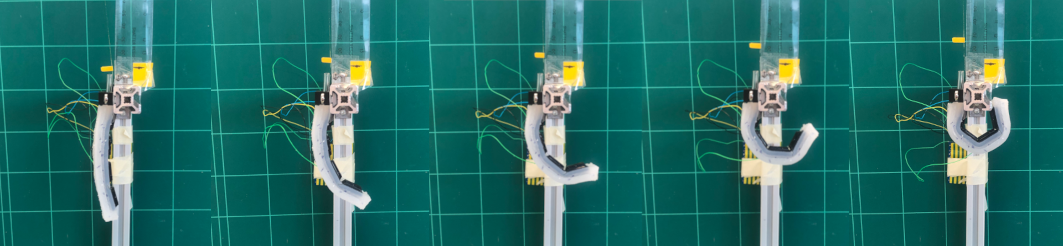
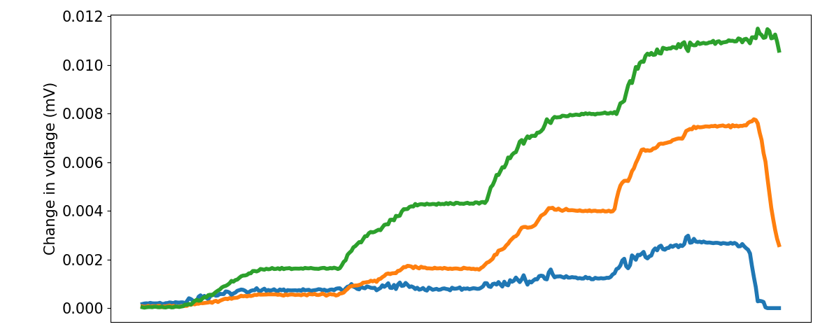
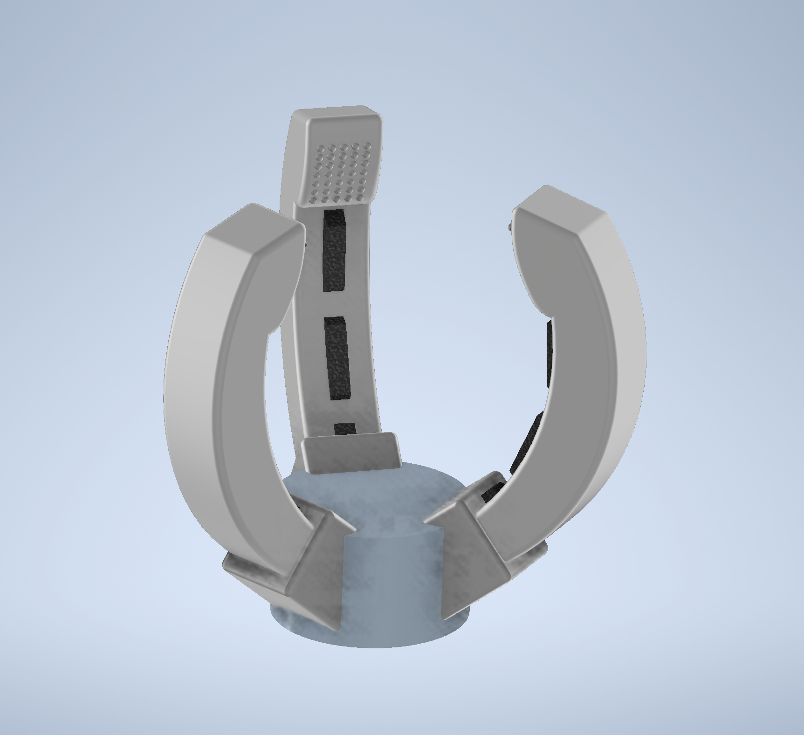
Sensing Soft Robot Actuation with Electrical Impedance Tomography
Charles DeLorey, Mark Runciman, Saina Akhond, James Avery, George Mylonas
The Hamlyn Centre, Institute of Global Health Innovation,
Imperial College London, United Kingdom
Introduction
Soft robots are notoriously difficult to characterise due to their lack of rigid joints and precise end effector control [1]. In domains such as prosthetics and minimally invasive surgery (MIS), rigid-body robotics are predominantly used for their mechanical strength and solvable motion mechanics. However, soft robots have a gentler interface with objects and their compliant nature circumvents these difficulties in motion planning that rigid, jointed robots face. Specifically, compliant interfaces and sensor-dense actuation fit well to soft robot grippers and end effectors.
Use of rigid sensors is antithetical to the design and desired behaviour of soft robots. Therefore, soft sensing methods are developed to solve this problem. This project leverages electrical impedance tomography (EIT) imaging to produce low cost and accurate shape change sensing.
Method
The actuator is comprised of two systems: The cable-driven “backbone” piece (made from NinjaFlex flexible TPU) and the silicone EIT chamber. Shape Deposition Manufacturing (SDM) enables monolithic silicone casting of these systems. The backbone provides structure for cable actuation and the silicone body grants a soft and compliant interface with target objects.
Cable
Flexible backbone
(a)
Saline chamber
Silicone body
Electrodes
(b)
Figure 2 - (a) Actuator (side view) with cable-driven actuation and EIT saline chamber. Electrodes are placed facing into the chamber along the actuator. (b) Top view of EIT chamber with the three electrode pairs.
In this project EIT is used to sense deformation (bending) at the joints of the actuator by measuring impedance between electrodes. Current is injected between two electrodes on either side of a bend. As the actuator bends the distance between electrodes change, changing the impedance, which is registered as a voltage value.
(a)
(b)
Δd
(c)
o
o
o
o
o
o
d
o
d
o
o
o
o
o
o
o
o
o
o
Figure 1 – Soft manipulators of varying hardness. (a) Human arm, (b) soft robot arm, a (c) rigid robot arm and (d) soft, (e) medium and (f) hard fingers [2].
o
Figure 3 – EIT actuator with current length visualised (orange curves) in (a) top view, (b) side view, and (c) side view flexed. Red ‘o’ are electrodes.
Results
Preliminary results show clear bend sensing with just six electrodes. The actuator was flexed via cable pull between 0 and 20mm, in increments of 5mm. The maximum measured voltage change was (i) 0.002, (ii) 0.007, and (iii) 0.011 mV. The greatest voltage change was where the greatest bending angle occurred, closest to the actuator tip.
Future Work
Add more electrodes to improve sensing resolution. Consider using a flexible printed circuit (FPC) with electrodes to simplify actuator manufacturing.
Extend object and force sensing capabilities with a fingertip-like EIT-based sensor system.
Rework actuator design based on human finger instead of a constant curvature approach.
Compare full EIT image to voltage data.
With a significant amount of impedance and cable length data, a machine learning method (such as deep learning or LSTM) will be used to correlate cable actuation to voltage change for closed-loop control.
(b)
(c)
(d)
(e)
(f)
(c) (d) (e) (f) (g)
(b)
(i)
(ii)
(iii)
Textured fingertip
(iii)
Interior EIT chamber
(a)
(ii)
Cable actuation backbone
(i)
0mm
5mm
10mm
15mm
20mm
Gripper base
Figure 4 - (a) EIT voltage changes at bend points during cable actuation, with (b) corresponding electrode pairs (i-iii). Cable-driven actuator pulled to (c) 0mm, (d) 5mm, (e) 10mm, (f) 15mm and (g) 20mm.
Figure 5 - Rendering of gripper with three EIT actuators, each with an additional sensing fingertip.
References
[1] T. George Thuruthel et al., “Control Strategies for Soft Robotic Manipulators: A Survey,” Soft Robotics, vol. 5, no. 2. 2018, doi: 10.1089/soro.2017.0007.
[2] D. H. Kim et al., "User perceptions of soft robot arms and fingers for healthcare," 2016 25th IEEE International Symposium on Robot and Human Interactive Communication (RO-MAN), 2016, pp. 1150-1155, doi: 10.1109/ROMAN.2016.7745253.
Contact: Charles DeLorey, c.delorey20@imperial.ac.uk

